Slide 1

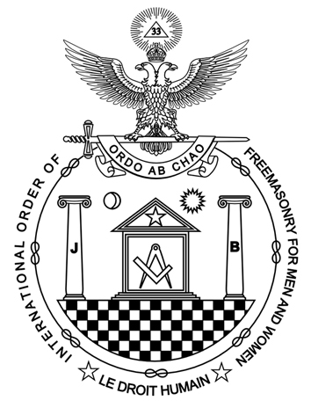
The South African Federation
The 100 year history of Co-Freemasonry in SA

Slide 2
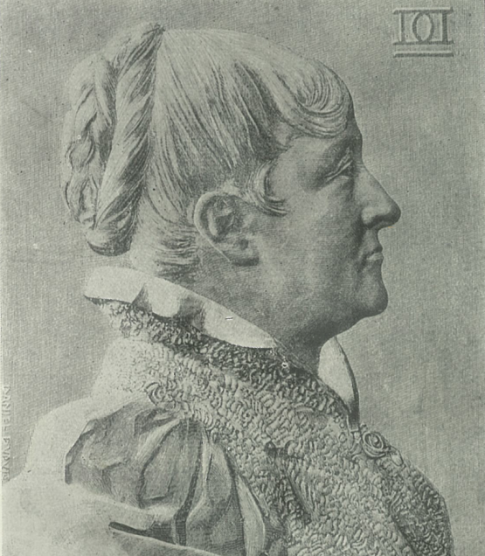
“the door that you have opened for me, shall not be closed behind me, and an entire legion will follow me…”
Marie Desraimes, January 1882
Notes:
Having reached this milestone the SA federation must ensure that we keep that gate wide open.

Slide 3
The time line outlines the development of Freemasonry for men and women in S.A.

Slide 4
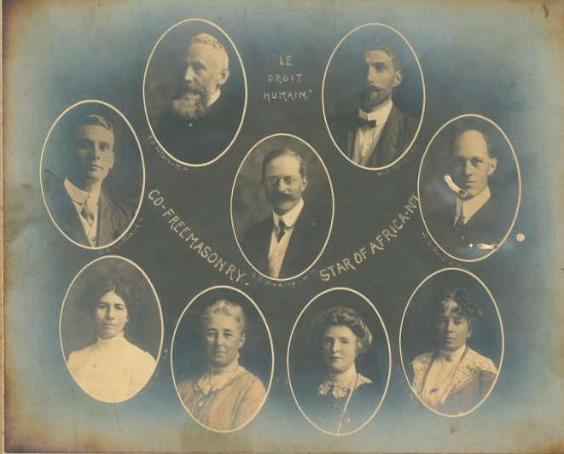
The First Triangle is set up in Johannesburg
on Easter Monday 24 March 1913
By Brethren of Emulation Lodge no. 14, London,
Only one meeting was held. Charter was returned.

Slide 5



Ethol Pullen Berry
Janet Gillian (Havik)
William Ernest Marsh
Travelled to London by mail steamer to enquire about the new
Universal Co-Freemasonry.
Notes:
Was it the intellectual challenge that drove three determined people –
Ethel Pullen bury
Janet Isobel Gillian ( later Havik) ,
William Ernest Marsh

Slide 6
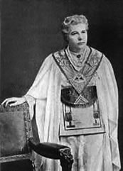
They met The V. Illus. Sister Annie Besant 33º, the founder of Lodge Human Duty no 6 in London.
They were initiated, passed and raised, entrusted with a provincial charter, rituals and some rudimentary instruction.
They returned to the Union of
South Africa
to start the order in SA.
Notes:
The V Illus Sister Annie Besant 33, under the Supreme Council in Paris had founded the Lodge Human Duty no 6 in London
The three seekers , having been initiated, passed and raised, entrusted with a provincial charter, rituals and some rudimentary instruction, returned to Durban to start the order in SA .
At the golden celebration of Masonry in SA, The Illus Sister Janet Havik described their first meeting as follows

